Slide 1


Master case pack 4 or 8 are available
Item #: | 16111-4 | 16111-8
UPC: | 097298061738 | 097298061738
GTIN: | 30097298061739 | 20097298061732
Package Weight: | 8.2oz | 8.2oz
Package Dimensions: | 2d x 5.62w x 6.75h | 2”d x 7”w x 7”h
Master Carton Weight: | 2.15 lbs | 5.01 lbs
Master Carton Dimensions: | 8.5d x 7w x 7h | 8.88d x 14.38w x 7.25h

Slide 2
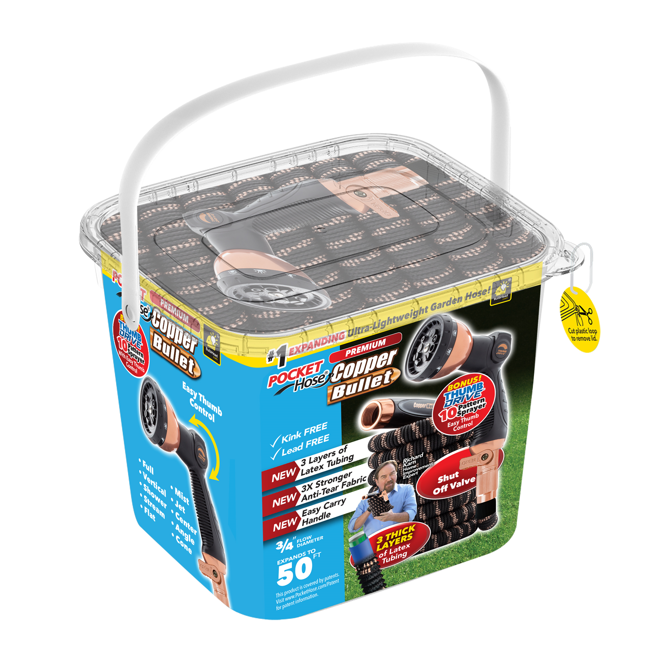
2024
Our finest Pocket Hose to date
Over 100 patents
New
  Copper infused connectors – 20% larger
  Easy grip nozzle with thumb drive – 10 pattern sprayer
  Over sized shut off valve
  3 layers of latex tubing
  3x stronger Anti-Tear fabric
Still lead free and drinking water safe
¾ inch flow diameter
Reusable storage tub

Slide 4
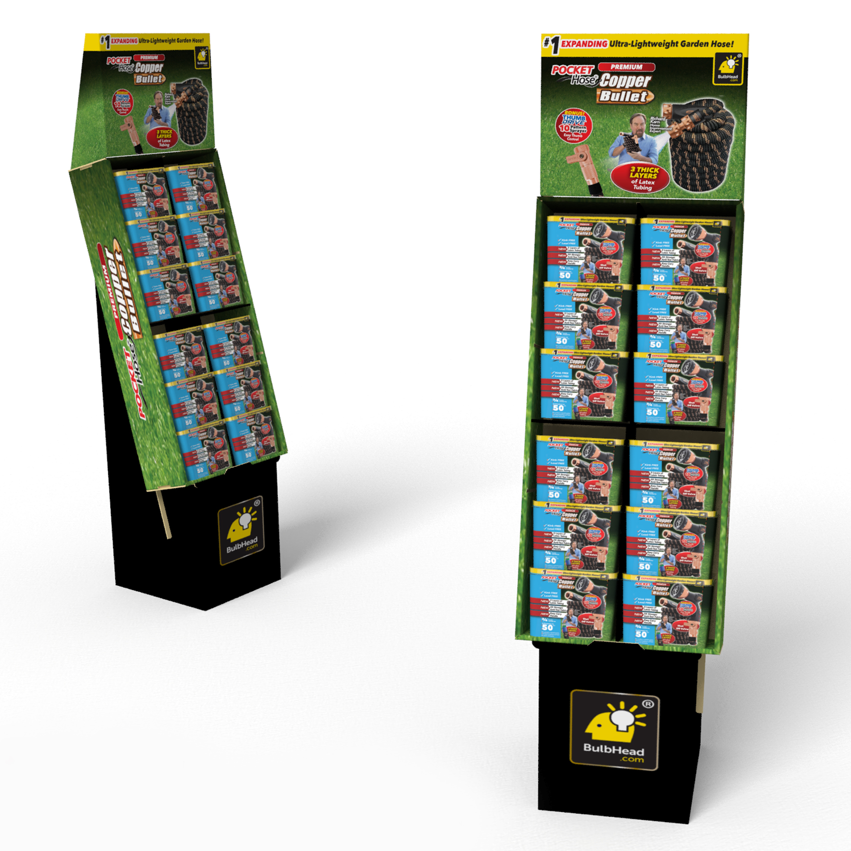
12 piece 50’ Copper Bullet Floor Displayr Bullet Hose 50’ Fl12oor Display
Item #: | TLB17192FD12
UPC: | 097298078521
GTIN: | 20097298078525
Master Carton Weight: | 24 lbs
Master Carton Dimensions: | 8.5”d x 16.25”w x 42.75”h
Master Carton Cube: | 3.42

Slide 5
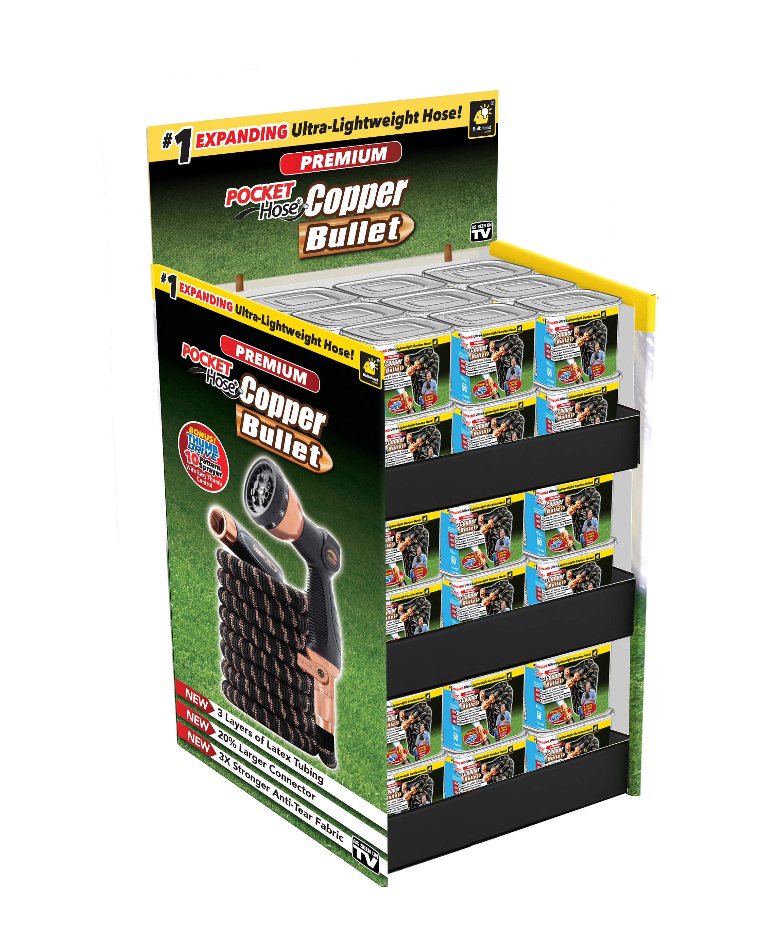
30e30 piece Mixed Copper Bullet Quarter Pallet
3ce Mixed Quarter Pallet / 50’,75’&100’ Copper Bu3ll3et hose333
Item #: | TLB17233QP30
UPC: | 097298078590
GTIN: | 10097298078597
Master Carton Weight: | 90 lbs
Master Carton Dimensions: | 24.50”d x 20.25”w x 43.25”h
Master Carton Cube: | 12.42
Notes:
18 Fifty footers – 6 Seventy-five footers – 6 One hundred footers

Slide 6


Slide 7

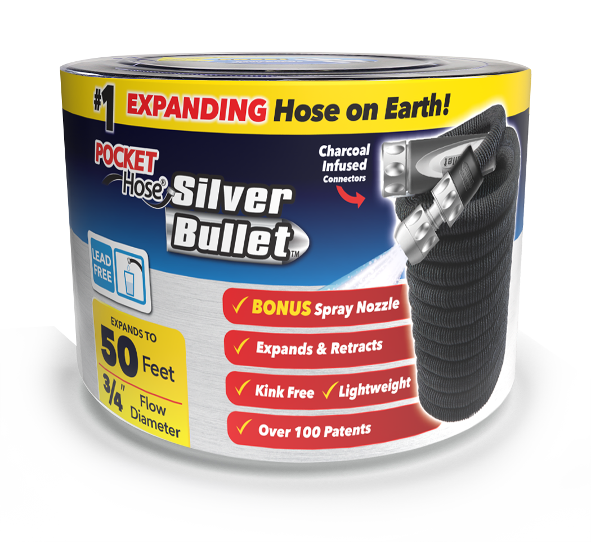
2024
#1 best selling expanding hose on earth
Over 100 patents
Over 50 million units sold
Machined aluminum Spray nozzle included
Machined aluminum connectors
  Lead free
  Drinking water safe
Connector sleeves on both sides
¾ inch flow diameter

Slide 8
Pocket Hose Silver Bullet 50’ | 12 Pack | 12 Piece Floor Display
Availability:NOW
Item #: | TLB1339712 | TLB13397FD12
UPC: | 097298072345 | 097298072345
GTIN: | 20097298072349 | 60097298072347
Package Weight: | 1.72 lbs | 1.72 lbs
Package Dimensions: | 6.625d x 7.3125w x 5.875h | 6.625d x 7.3125w x 5.875h
Master Carton Weight: | 26.35 lbs | 25.64 lbs
Master Carton Dimensions: | 21.41”d x 15.90”w x 14.76”h | 9”d x 16.5”w x 44.38”h
Master Carton Cube: | 2.8 | 3.81
Ti/Hi: | 6/5 | 13/1
Pocket Hose Silver Bullet 75’ |  | Pocket Hose Silver Bullet 100’
Availability:NOW | 6 Pack | 6 Pack
Item #: | TLB134896 | TLB134906
UPC: | 097298072642 | 097298072659
GTIN: | 10097298072649 | 10097298072656
Package Weight: | 2.35 lbs | 3 lbs
Package Dimensions: | 7.625”d x 8.875”w x 5.875”h | 8.5”d x 9.75”w x 5.9”h
Master Carton Weight: | 15.35 lbs | 19.25 lbs
Master Carton Dimensions: | 23”d x 7”w x 18.25”h | 26”d x 20”w x 6.45”h
Master Carton Cube: | 1.58 | 1.94
Ti/Hi: | 10/4 | 10/4

Slide 9
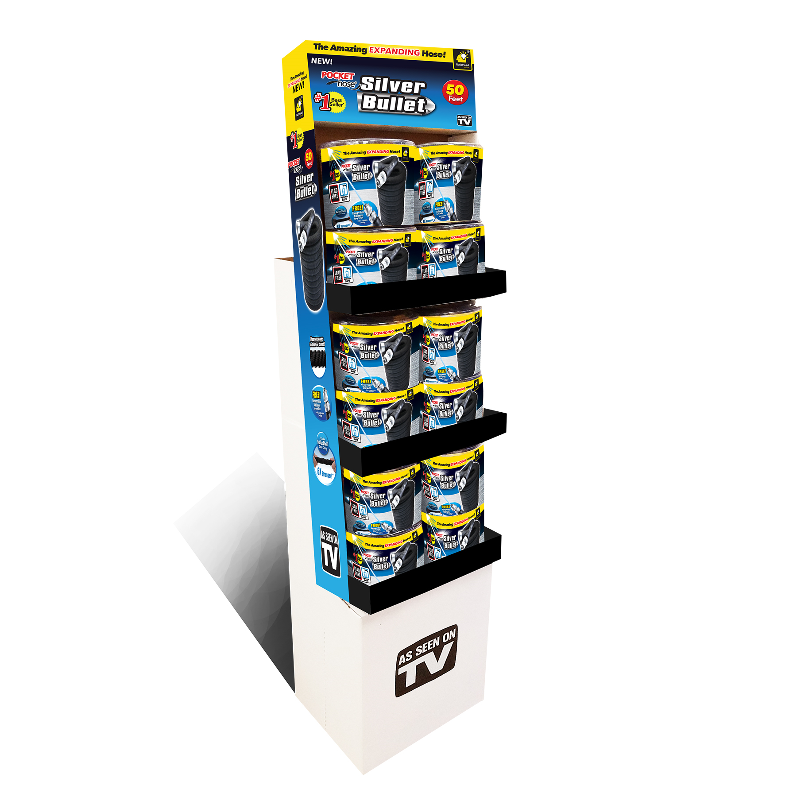
5412 piece 50’Silver Bullet Floor Display piece Quarter Pallet / 50’ hose
Item #: | TLB13397FD12
UPC: | 097298072345
GTIN: | 60097298072347
Master Carton Weight: | 25.64 lbs
Master Carton Dimensions: | 9”d x 16.5”w x 44.38”h
Master Carton Cube: | 3.81

Slide 10
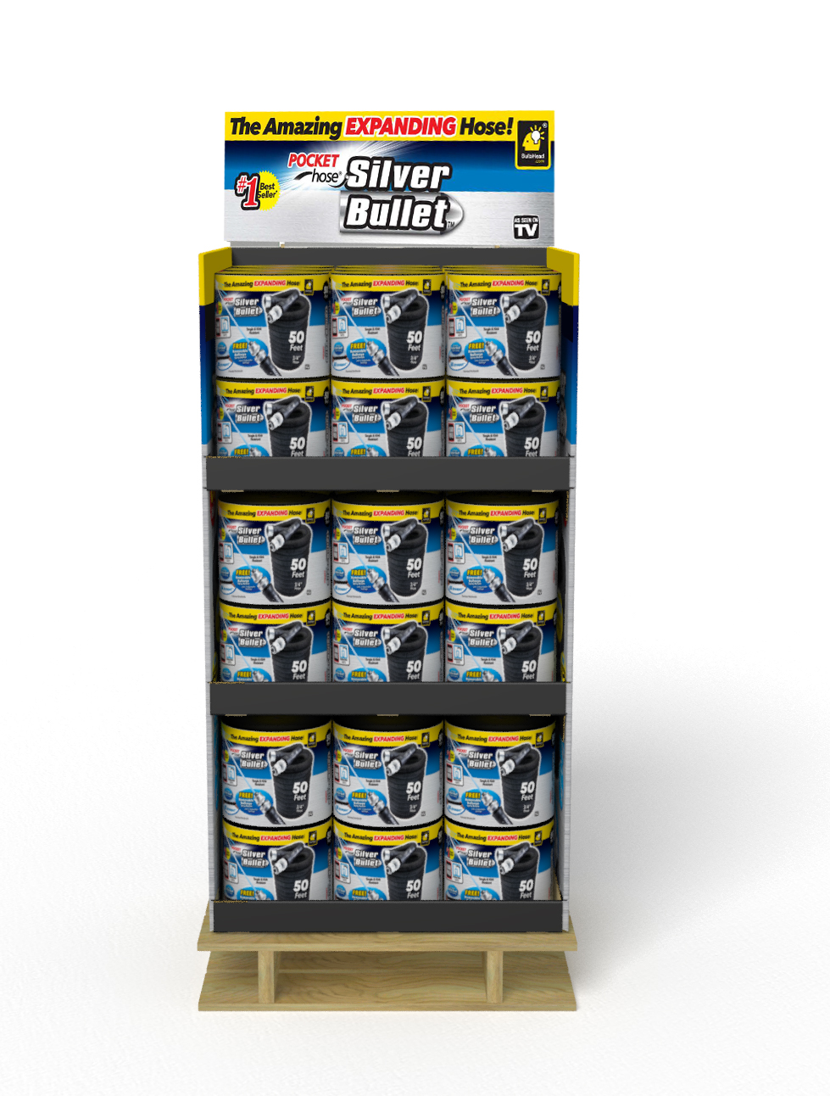
54-p54 piece 50’ Silver Bullet Quarter Pallet iece Quarter Pallet / 50’ hose
Item #: | TLB13397QP54
UPC: | 097298072345
GTIN: | 50097298072340
Master Carton Weight: | 118.88 lbs
Master Carton Dimensions: | 23.75”d x 21.75”w x 35”h
Master Carton Cube: | 10.46

